Slide 1

Twitter Data Analysis
Team Members –
1.Ayushi Singh – 1PI13IS029
2.Satvik Khetan – 1PI13IS096
3.Shubham Vatsal – 1PI13IS105
Guided By – Prof. Raj Alandkar

Slide 2
Introduction
Twitter is among the most influential social networking platforms.
Twitter is used mostly for : Microblogging , expressing opinion , giving reviews etc.
Twitter is powerful enough to influence people and to be used as a tool.
Rather than just reading tweets from your timeline , why not get a overall review of the topic on twitter which is trending before making a opinion ?

Slide 3
Introduction contd..
Our project provides a isometric view of the result obtained from analysis on the topic of interest for better understanding .
Eg : Hour wise , location wise etc.
It helps you formulate a more appropriate view of the topic at hand so that the bad influence caused by incomplete information can be avoided.
And our output through qlikview makes it more user friendly.

Slide 4
Problem Statement
A Prototype to provide more accurate and summarized insights on several topics through twitter data
For eg : if the current trend on Twitter is #demonitisation , the prototype provides you with a clear and summarized insight on the topic, through various types of analysis such as most frequently used hashtags , hour wise response of users etc.

Slide 5
Motivation
Social media Analysis is an integral part in most of the companies that deal with people in a direct way.
It helps the companies to plan their strategies and schemes and trace patterns of customer preference by studying the analysis through social media platform.
Twitter allows us to do analysis of expressed mood and geographical, durinal , weekly and seasonal patterns of positive and negative affect can be observed.
A step towards making the society more data driven , by converting large amount of data to useful knowledge.

Slide 6
Motivation ..
As of 2016 nearly 22 million Indian use Twitter, and is expected to cross 30 million by 2019.
People actively tweet about several topics such as politics, sports, movies, incidents, etc.

Slide 7
Input
For a trending topic : The input for the prototype is the tweets related to that topic. It is in the form of a excel file.
For ecommerce site analysis : The tweets for @flipkartsupport are used to showcase it.
For product comparison analysis : Tweets related to Samsung and Apple are used to provide a user a comparison tab for mobile phones

Slide 8
Output
The Output consists of a dashboard made using a reporting tool named Qlikview.
The dashboard contains 4 Tabs
- The Welcome tab
- A general analysis tab that displays the analysis for a topic that was trending on twitter recently.
- An ecommerce tab that displays the analysis done using the reviews and tweets of people to @flipkartsupport
- A mobile comparision tab that allows the user to compare two phones using the tweets collected on two lates phones

Slide 9
Flowchart

Slide 10
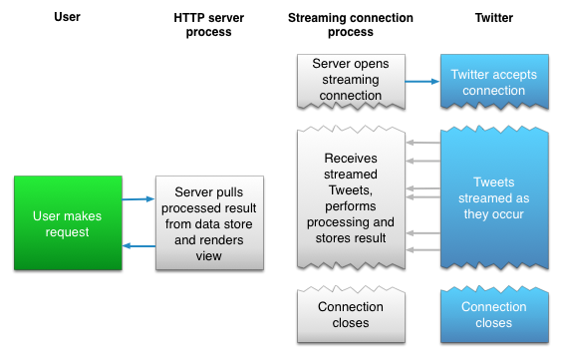
Streaming api using Tweepy

Slide 11
Using tweepy we try to stream tweets related to a particular topic or particular twitter handle.
Before streaming a listener is created and the keys and tokens for authentication are set using OAuthHandler() function from tweepy.
The stream() function is called to get the tweets. Arguments passed to this function are the authentication object and the listener object.
We apply stream.filter() with arguments such as track=[“#demonitisation”] and languages=[“en”] to stream only tweets which we are interested in.

Slide 12
Whenever a new tweets comes up the on_data() functions is called
In that function we clean the tweet using clean_tweet() which removes the unnecessary part in the text.
The cleaned tweet is sent to the classifier which provides the label for the tweet that whether it is positive, negative or neutral.
Then the tweet’s text along with the labels and other fields such as location, time etc are written to the corresponding row in the excel file.

Slide 13
Tweet Cleaning includes:
- Decoding data using json.decode(‘text’).Encode(‘ascii’,’ignore’)
- Removal of stopwords using a set of stopwords by importing stopwords from nltk.corpus.
- Removing punctuations using the punctuation list from the string library
- Finally using regular expression to remove the emojis and tokenize the text based on hashtags,mentions,etc

Slide 14
The final results are displayed through a reporting tool named Qlikview.
It is one of the best reporting tool in the market and is being used in many top companies such as ITC,TCS,Accenture,Wipro and many more.
It provides the user to obtain several kinds of information in a very easy and user friendly way.
In our project we are using Qlikview to create a dashboard which can be used to get various kinds of analysis through graphs and charts.

Slide 15
Data Classification
Hybrid classifier is being used to classify data.
Classification technique that involves usually a small number of heterogeneous methods, which act complementarily to each other. Each method solves a different task and the classification decision is reached by one method.

Slide 16
Hybrid classifier makes use of Support Vector Machine and K-Nearest Neighbour
A new tweet is first classified using K-Nearest Neighbour as either "objective" or "subjective". An “objective” tweet is classified as “neutral” by SVM whereas a “subjective” tweet is classified as either “positive” or “negative”.

Slide 17
Training Data
Feature Vectors
Cleaned tweets as input
Hybrid Algorithm
Labels
Feature Vectors
Predictive Model
Expected Labels

Slide 18
Implementation
Eg : demonitisation
Step 1 : Getting tweets which include hashtags of demonitisation and information of the people tweeting by using Twitter streaming API.
Step 2 : Convert the extracted tweets which are encoded in json using the json.decode()

Slide 19
Step 3 : Cleaning the tweet using some regular expressions and set of stopwords to clean the tweet and filter out the unnecessary text in the tweet so that it can be sent to the sentiment classifier.
Step 4 : Through the hybrid classifier of SVM and KNN classifiers, label the tweets to be either positive, negative or neutral.

Slide 20
Step 5 : Populating the excel file with several fields related with the tweet
Step 6 : Running different codes to provide more analysis on the tweets collected.
ex-Finding out the most frequently used hashtags in the tweets
Step 7 : Providing a summarised and accurate insight on demonitisation for better judgement using a reporting tool named qlikview.

Slide 21
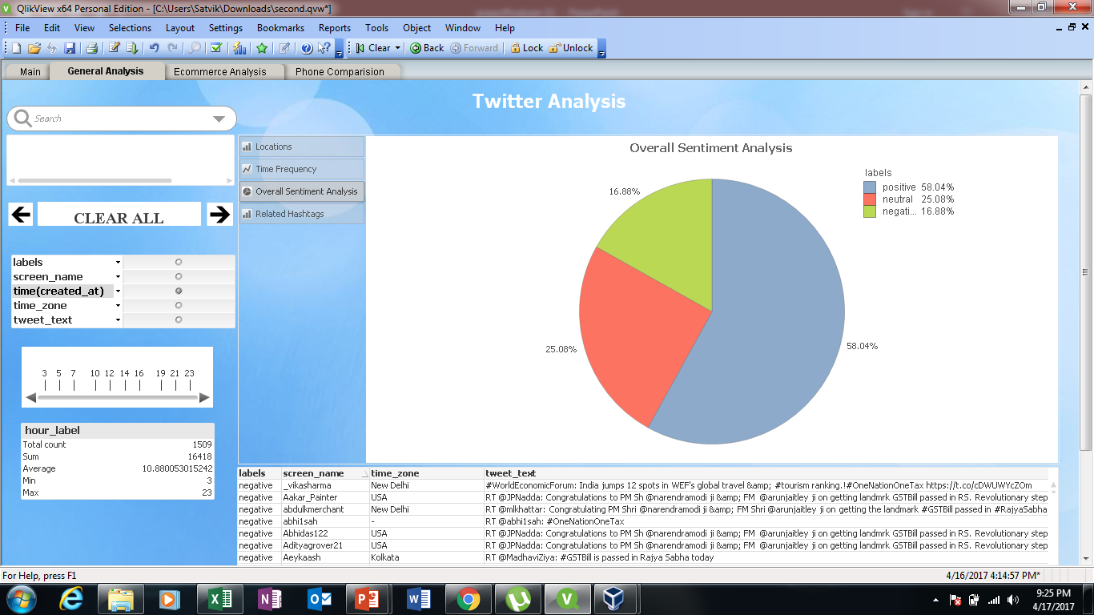
Results

Slide 22
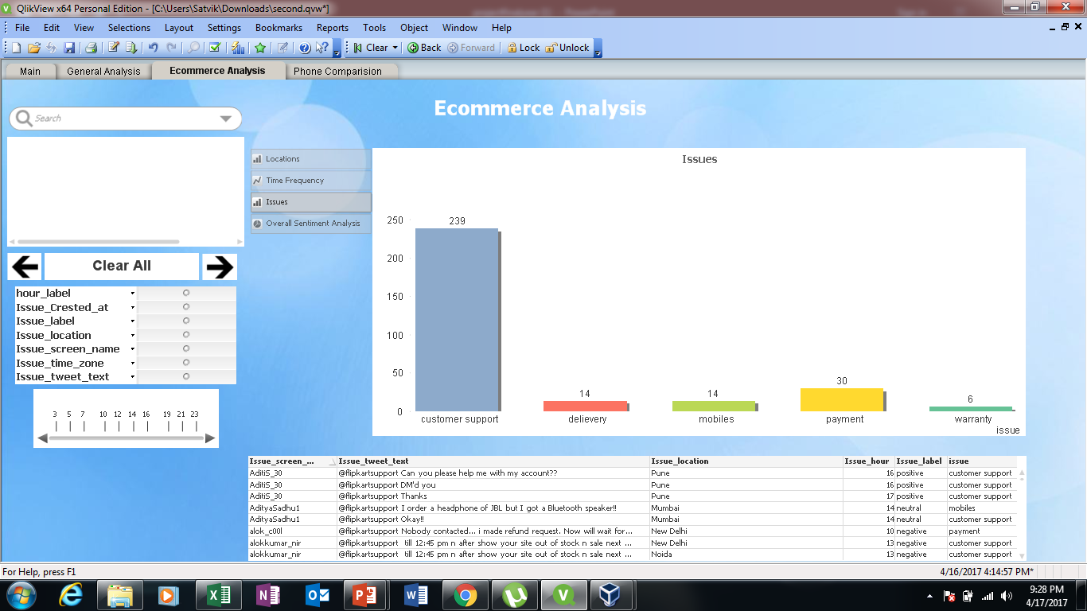

Slide 23
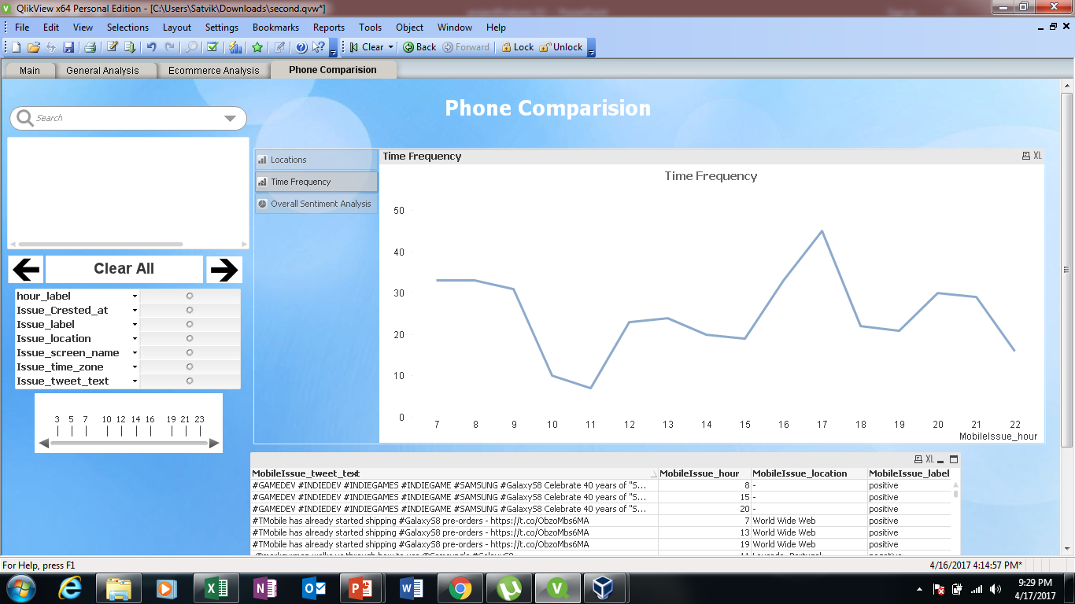

Slide 24
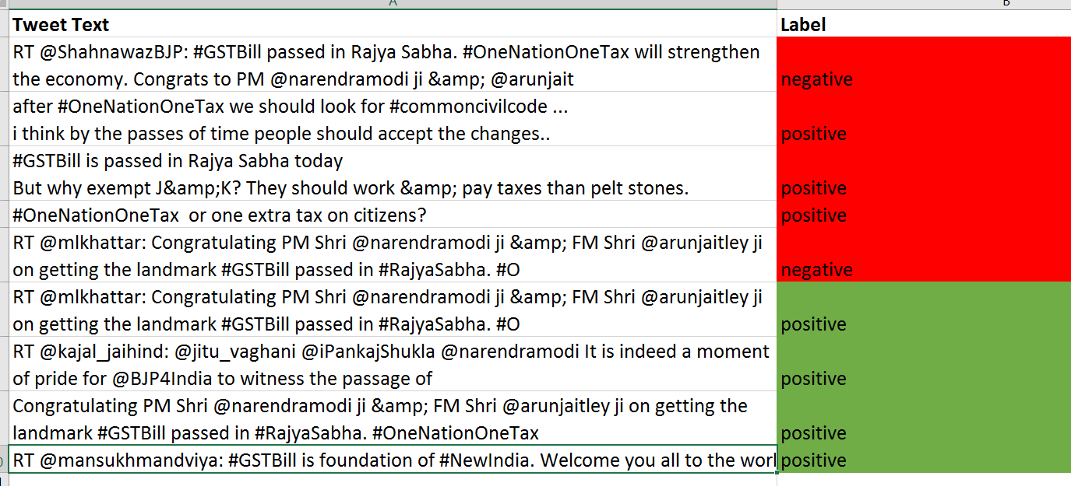
Test Results

Slide 25
Conclusion
Getting an analysis through social media is a very helpful and necessary method for most of the companies.
In our work we tried to showcase how some analysis can be withdrawn if the data from twitter is used in a proper way.
In our approach we have tried to keep the front end user friendly so that a normal person can also use it to gain an insight about some topic he/she is interested in

Slide 26
Future Work
Using a complete and latest set of all the tweets around the globe.
Extending the analysis for Flipkart to other ecommerce sites.
Extending the analysis for reviews on multiple products along with the mobile phones.
Expanding the analysis for other domains as well, ex-political campaigns, government schemes, etc.

Slide 27
References
Hassan Sayyadi , Matthew hurts and alexey maykov , Proceedings of the third international ICWSM conference 2009.Event detection and tracking in social streams.
A SURVEY OF TECHNIQUES FOR EVENT DETECTION IN TWITTER FARZINDAR ATEFEH AND WAEL KHREICH.
Bursty event detection from microblog: a distributed and incremental approach by Jianxin Li*,†, Jianfeng Wen, Zhenying Tai, Richong Zhang and Weiren Yu.
Detecting Events in Online Social Networks:Definitions, Trends and Challenges by Nikolaos Panagiotou, Ioannis Katakis, and Dimitrios Gunopulos.
Emerging event detection in social networks with location Sensitivity by Sayan Unankard & Xue Li & Mohamed A. Sharaf.
Analyzing and Predicting Viral Tweets by Maximilian Jenders,Gjergji Kasneci,Felix Naumann.

Slide 28
Literature survey
Event Detection and summarization based on social networks and semantic Query expansion by K. Sathiyamurthy1 and G. Shanmugavalli2 and N. Udayalakshmi3.
Event Detection in Social Streams by Charu C. Aggarwal And Karthik Subbian.
Event detection over twitter social media streams By Xiangmin Zhou and Lei Chen.
Event Identification in Social Media by Hila Becker,CMor Naaman and Luis Gravano.
Online Social Networks Event Detection: A Survey By M´ario Cordeiro1(B) and Jo˜ao Gama2.
Real-Time Classification of Twitter Trends by Arkaitz Zubiaag ,Damiano Spina, Raquel Mart´ınez, V´ıctor Fresno.
Sentiment-Based Event Detection in Twitter by Georgios Paltoglou.

Slide 29
Thank you

